Slide 1
COMPUTATIONAL DRAWING Sven Dekker Amsterdam University of Applied Sciences RobotLAB

Slide 2
About me Hello! I’m Sven Dekker A third-year mechanical engineering student at HvA, with a passion for innovation in production techniques. I’m currently immersed in a minor Robotic Production & Circular Materials. Where I explore cutting-edge developments with robotic arms. On weekends, I switch gears to bartending, drafting craft beer and creating memorable experiences. My goal is to stay at the forefront of innovation, whether it’s 3D printing, automation, or sustainable manufacturing. Visit my website at: sven-dekker.com
Notes:
Dive in the process – showcase how you work and how you came up with everything

Slide 3
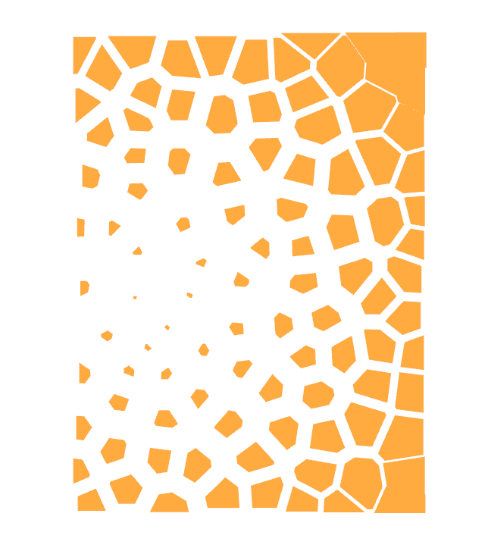
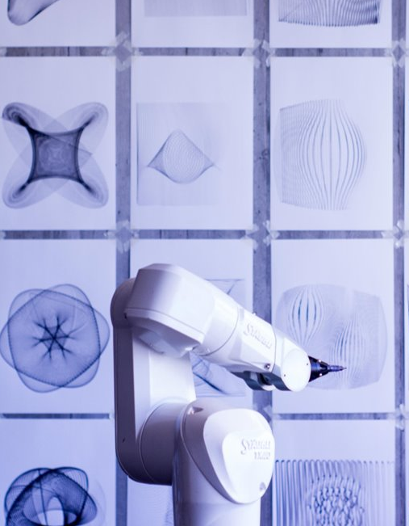
Voronoi Intro Computational Design Beginner's exercise to familiarize oneself with Rhino and Grasshopper: Creating a rectangle adorned with a Voronoi pattern and crafting a box featuring a similarly intricate Voronoi design
Notes:
Teaser
Quick description of your project in 500 – 1000 Signs
Teaser Image that shows enough of the project to make the viewer want to see more, but doesn’t show everything

Slide 4
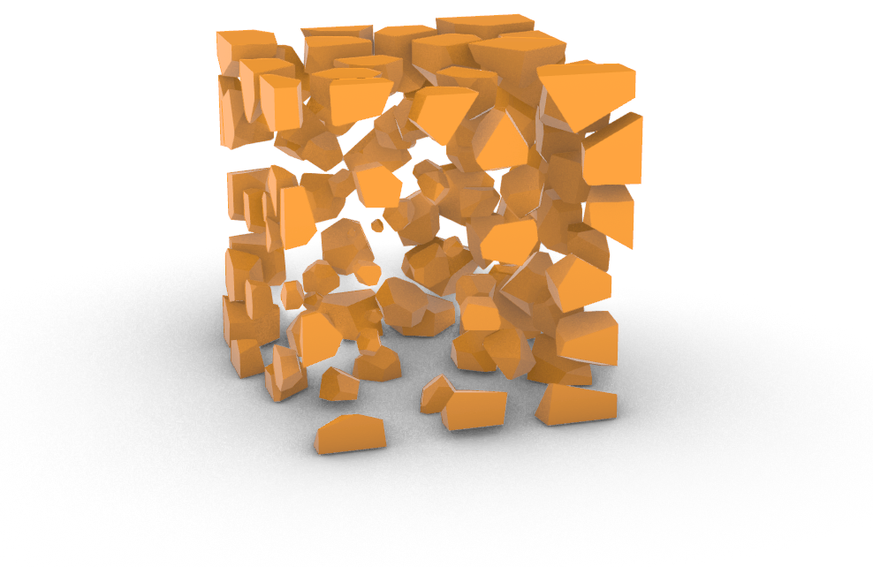
PROCESS Developing the Scripts The figures are the outcome of following a tutorial in Grasshopper and visualizing it in Rhino. Throughout this exercise, you gain insight into the infinite possibilities achievable in Rhino. This has truly excited me for what lies ahead.
Notes:
Dive in the process – showcase how you work and how you came up with everything

Slide 5
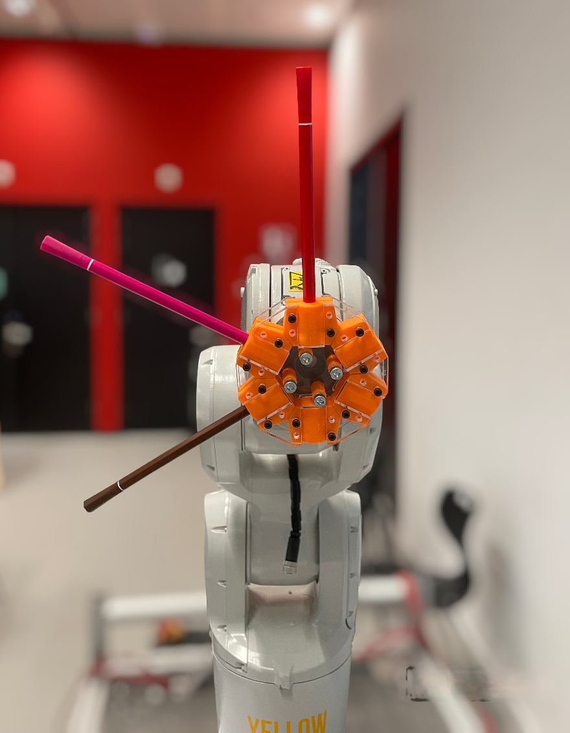
PROJECT End effector The task for this exercise was to design an end effector for the robotic arm capable of holding three or more colours and accommodating pens of various diameters. This end effector was necessary to execute a drawing with the robot using its Grasshopper script.
Notes:
Teaser
Quick description of your project in 500 – 1000 Signs
Teaser Image that shows enough of the project to make the viewer want to see more, but doesn’t show everything

Slide 6
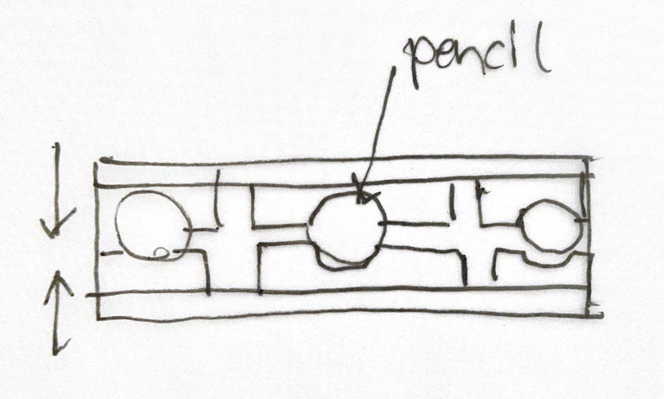
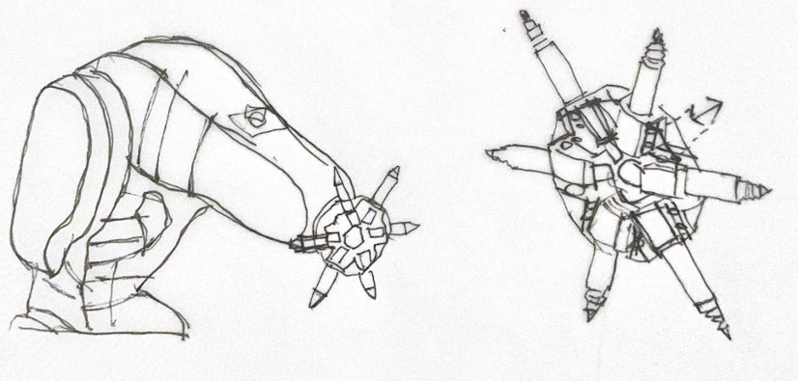
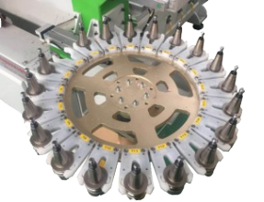
RESEARCH Inspiration & Sketches Before diving into the design phase, there was a thorough exploration of existing possibilities. Carousels emerged as a prominent option, frequently seen in CNC machines and boasting additional advantages. One notable benefit is the ease with which the TCP (Tool Center Point) for each tool can be managed—simply rotate the last axis of the robot arm and adjusting the z- axis offset to accommodate pencils of different lengths.
c
Notes:
Dive in the process – showcase how you work and how you came up with everything

Slide 7
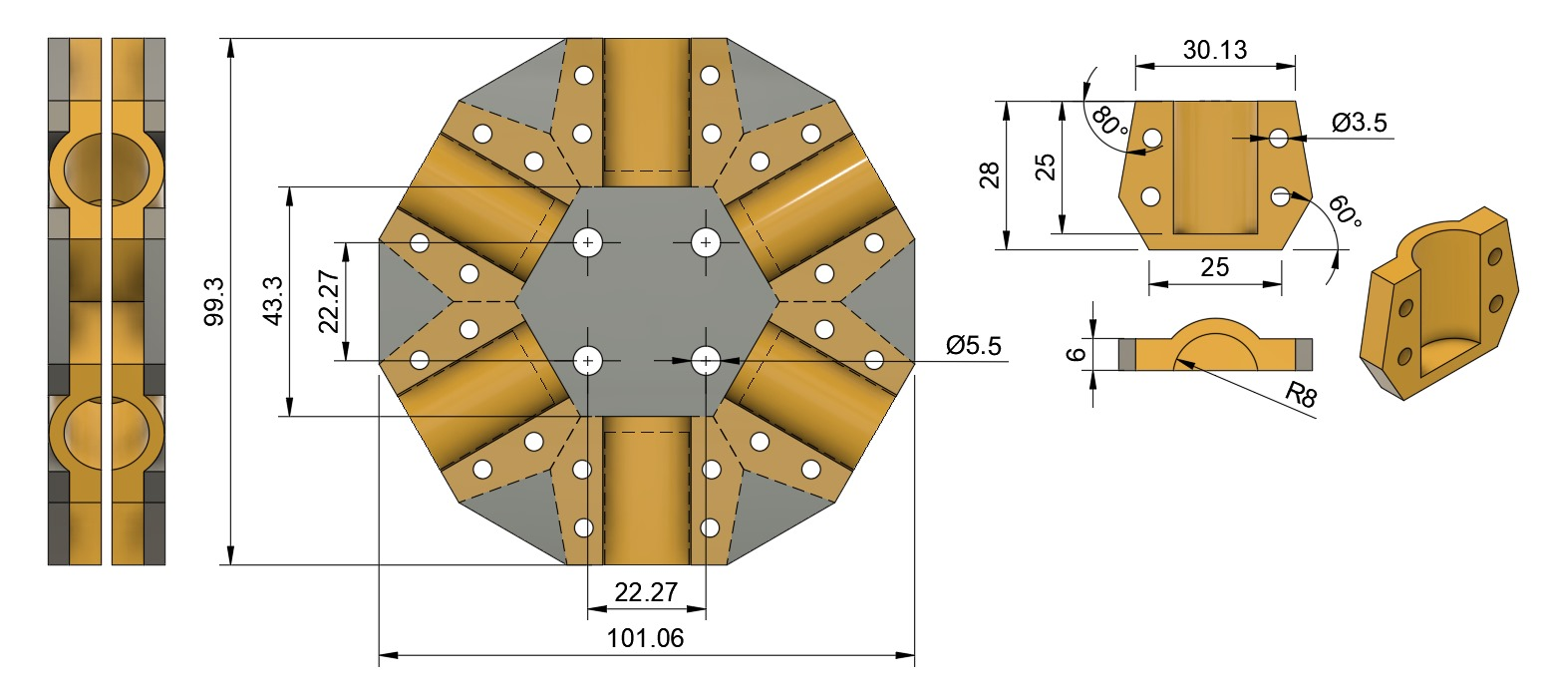
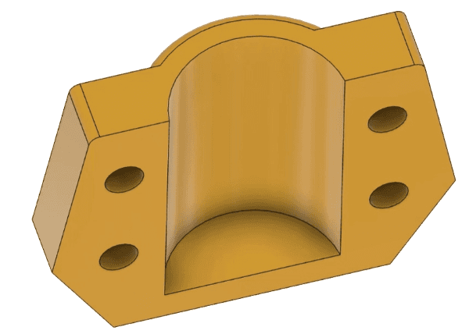
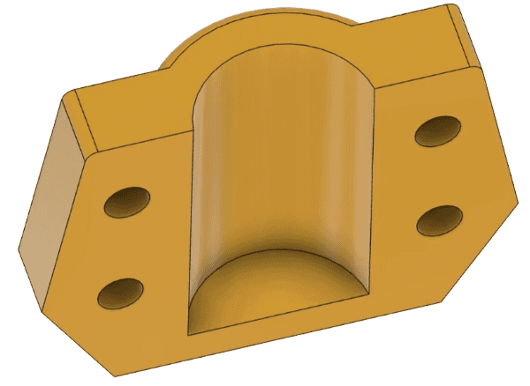
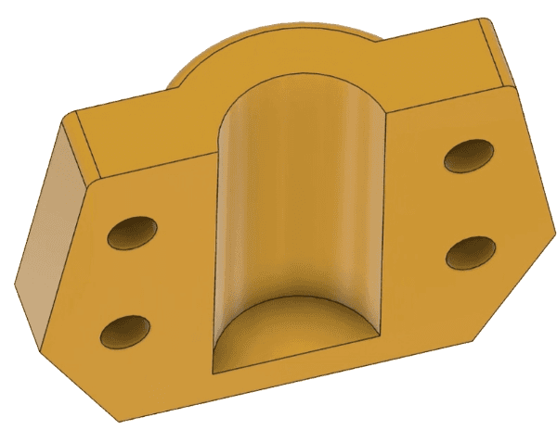
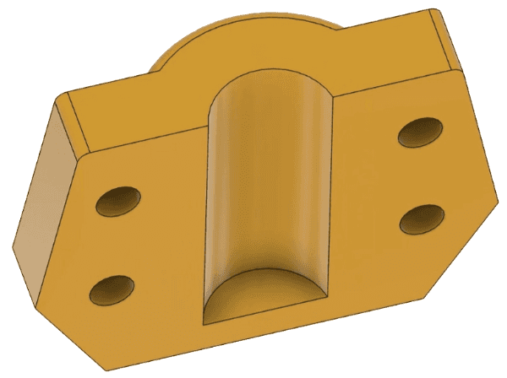
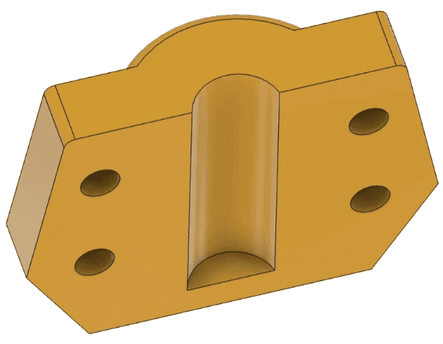
PROCESS Modeling Execution The modelling process was initiated from the sketches provided. The foundation of the end effector comprises a clamp shell designed to securely hold the pencils in place. Ensuring an even distribution of clamping force, two sturdy acrylic plates, each 5mm thick, were employed. To accommodate pencils of varying sizes, interchangeable insets were 3D printed in different dimensions. These insets can be effortlessly swapped out by removing just two screws, offering flexibility and ease of adjustment.
c
16 mm
14 mm
12 mm
10 mm
8 mm
Notes:
Dive in the process – showcase how you work and how you came up with everything

Slide 8
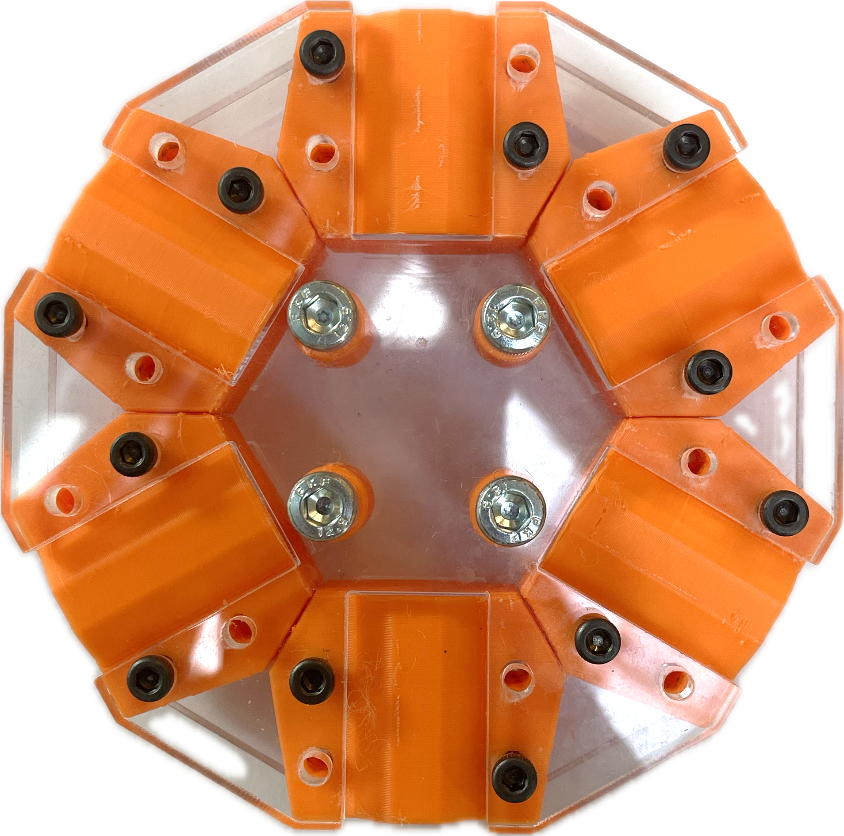
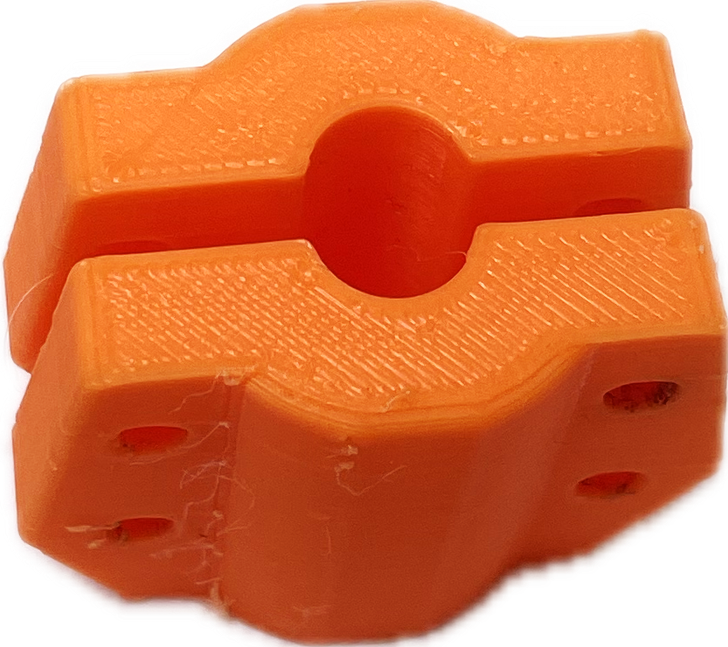
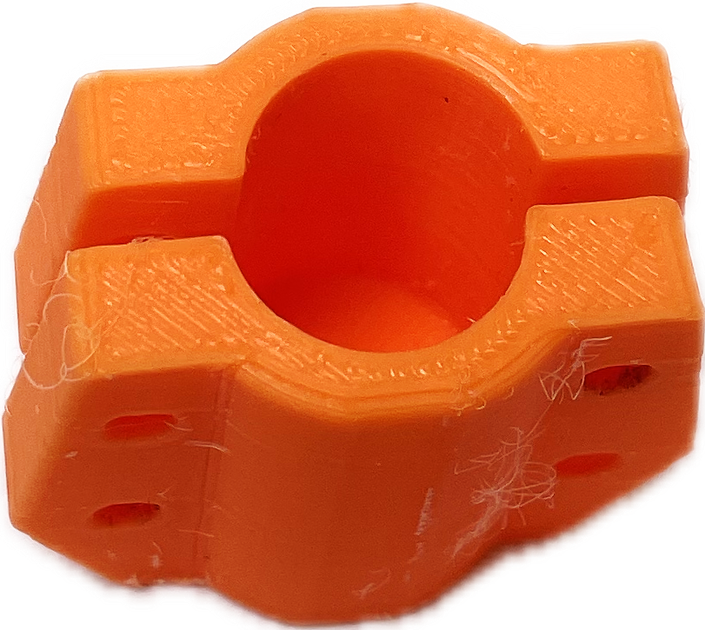
VISION Parametric Design The design was conceived with a clear vision: to seamlessly integrate the requirements of accommodating multiple pencils of varying diameters while ensuring a visually appealing and circular form. Incorporating two pressure plates minimizes the size of interchangeable components, maximizing reuse of the end effector during tool changes. Additionally, this design offers the advantage that only the necessary parts need to be disassembled when changing to a tool with a different diameter.
c
c
c
Notes:
Dive in the process – showcase how you work and how you came up with everything

Slide 9
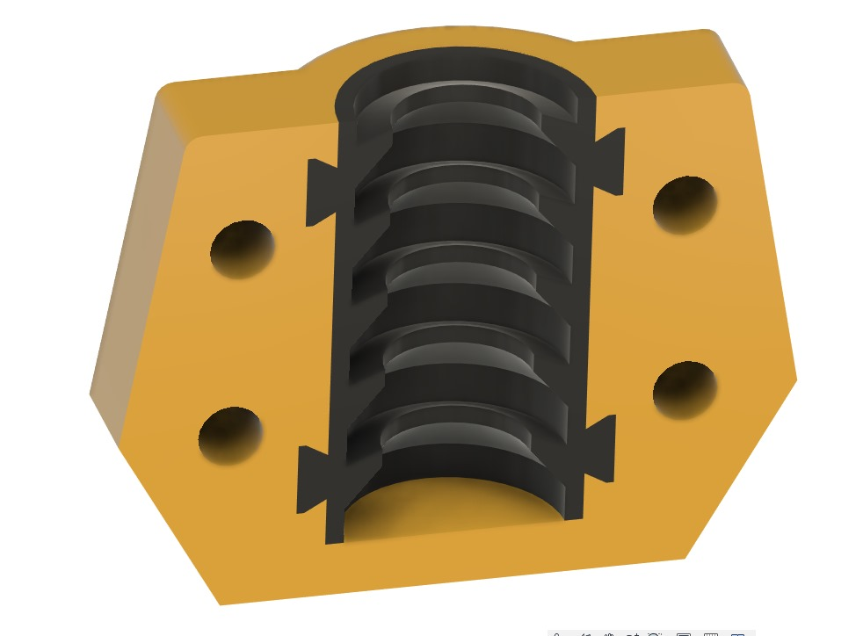
REFLECTION Learning progress While using the end effector, it was observed that it performs optimally when positioned at a 45º angle. An unforeseen advantage of clamping the pencils at their end is that the pencils themselves act as a sort of spring, facilitating consistent contact with the paper. Additionally, a design was developed to incorporate TPU (thermoplastic polyurethane) in the clamping mechanism, enabling it to accommodate pencils of various diameters without requiring interchanging the clamps. However, printing this particular component posed a significant challenge with the available 3D printer.
Notes:
Dive in the process – showcase how you work and how you came up with everything

Slide 10
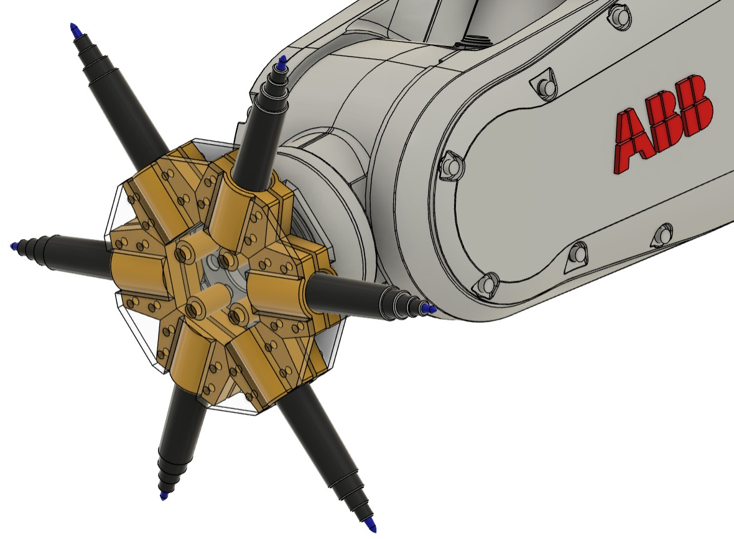
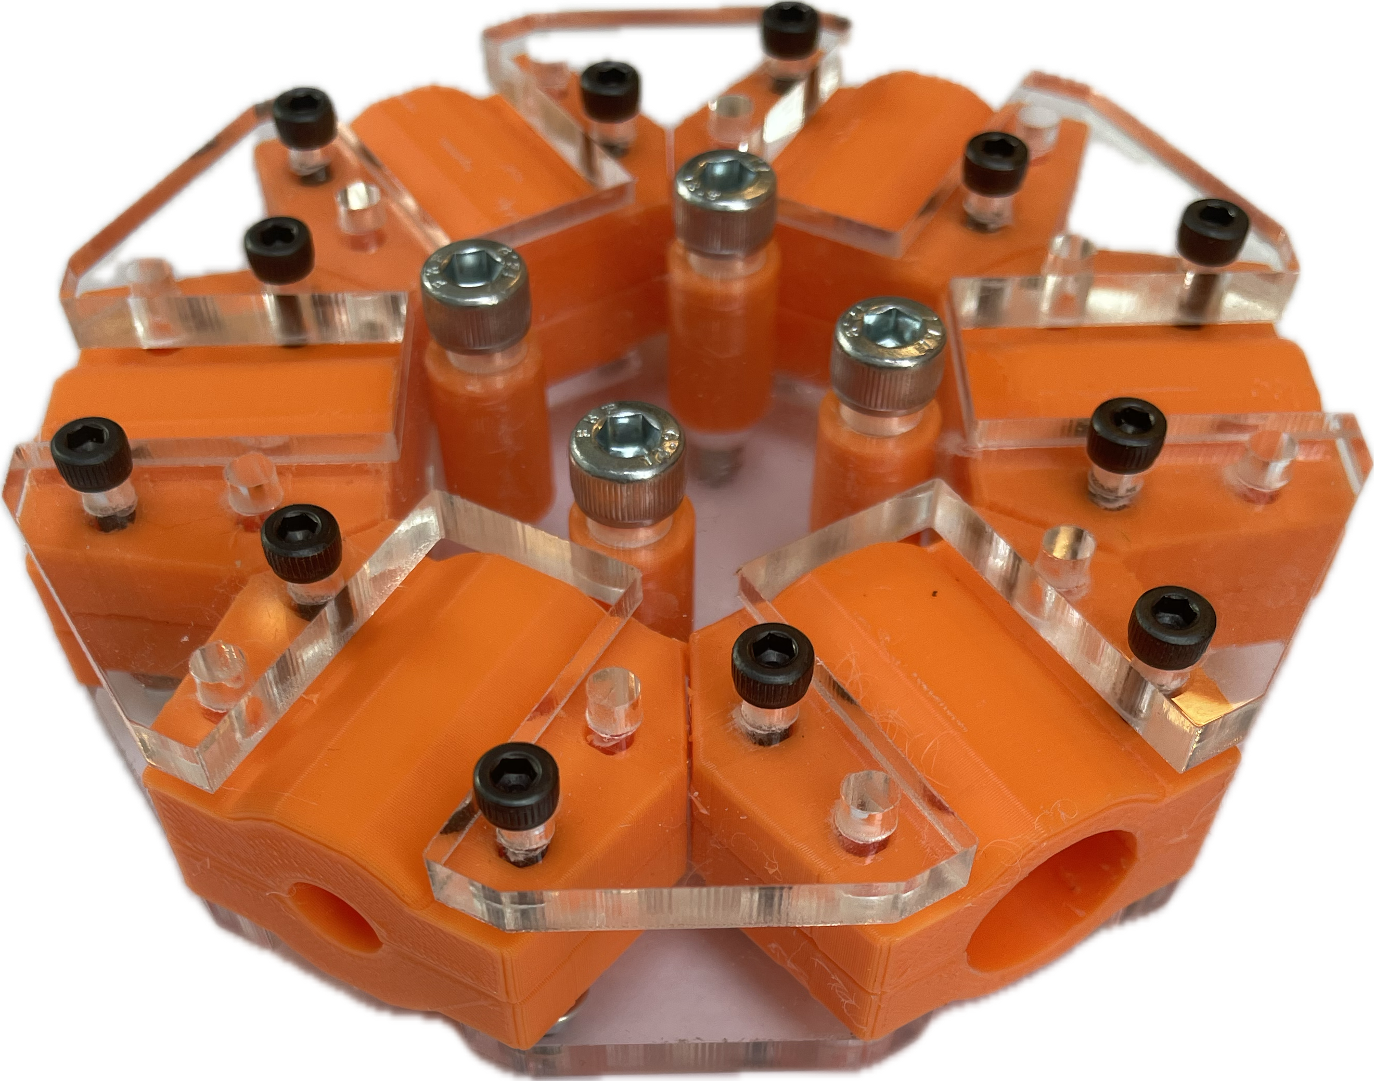
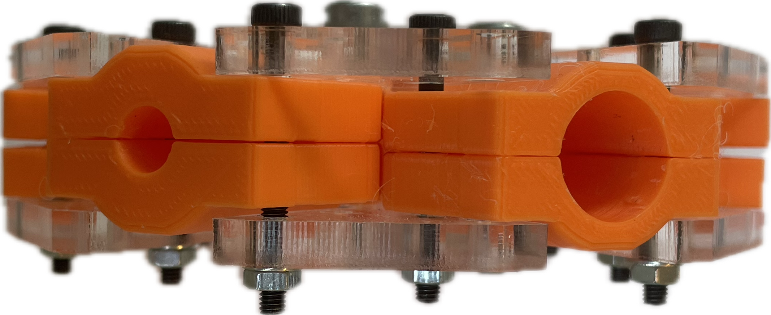
Notes:
Hero shot
Close the projects with some hero shots the show your results in the best way possible

Slide 11
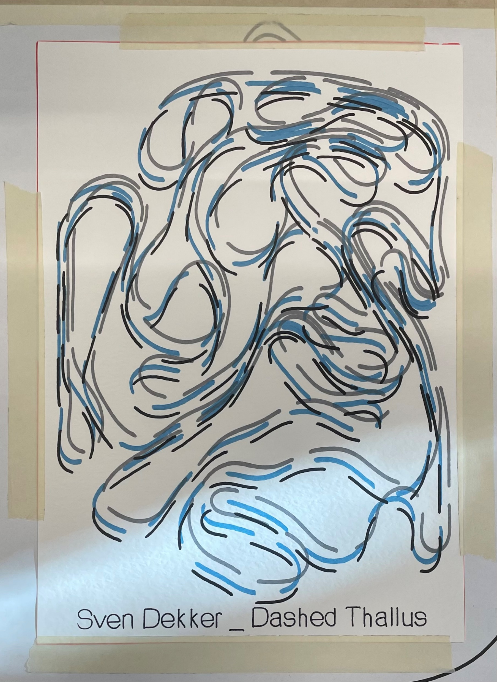
PROJECT Drawing The objective of this exercise was to produce a drawing using the customized end effector. The drawing required the utilization of multiple colours and various types of pencils. The design generated in Grasshopper served as the input for the script responsible for generating toolpaths for the robot. The primary focus of the exercise was to divide the design and allocate each segment to the appropriate tool, while also integrating the points for lifting and lowering the end effector as necessary.
Notes:
Teaser
Quick description of your project in 500 – 1000 Signs
Teaser Image that shows enough of the project to make the viewer want to see more, but doesn’t show everything

Slide 12
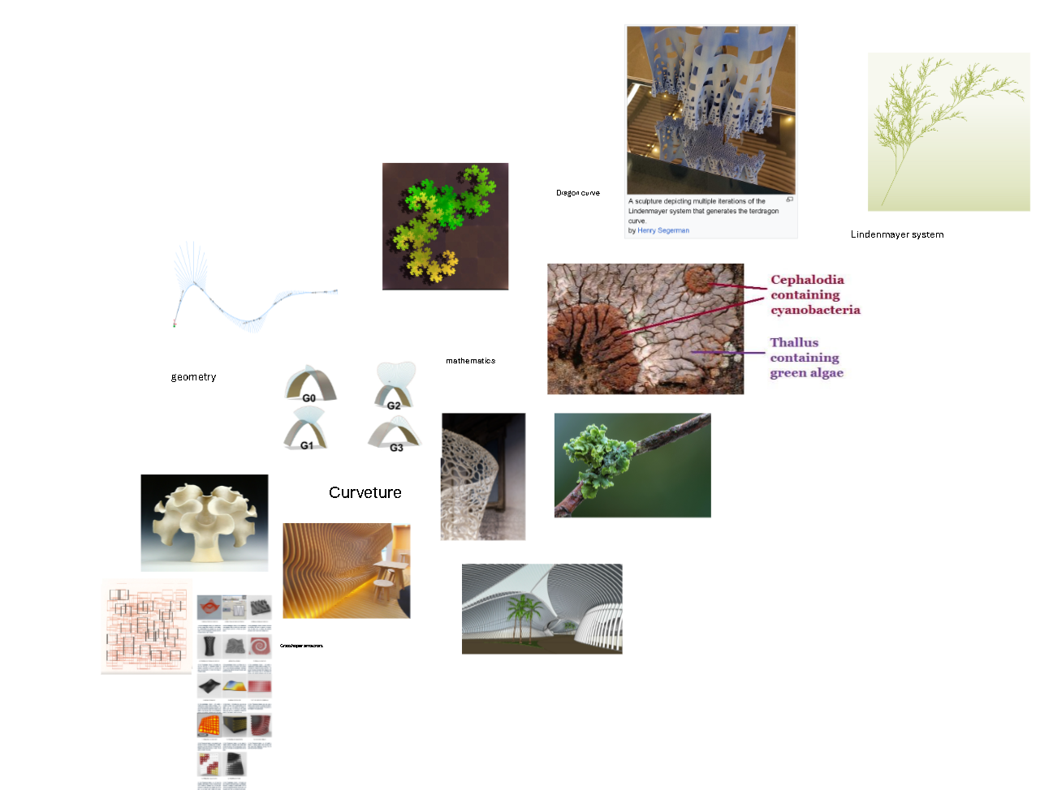
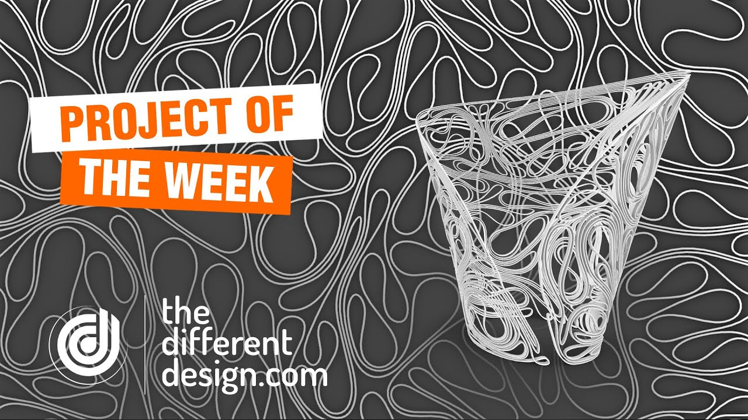
RESEARCH Tutorials & Mood board To begin the design process, I delved into tutorials to explore the possibilities and gather inspiration. Drawing from the insights gained, I then created a moodboard to refine and enhance the vision further.
Notes:
Dive in the process – showcase how you work and how you came up with everything

Slide 13
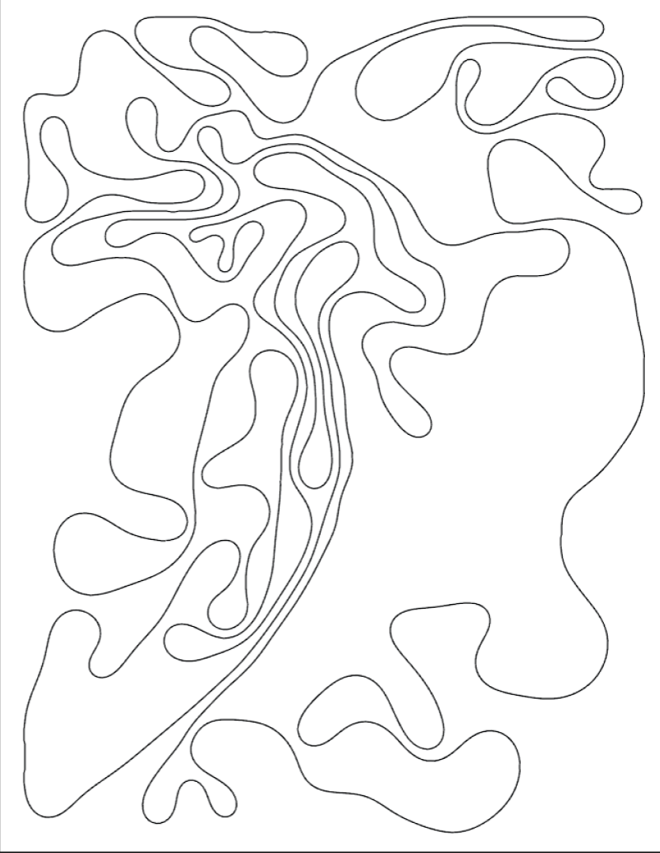
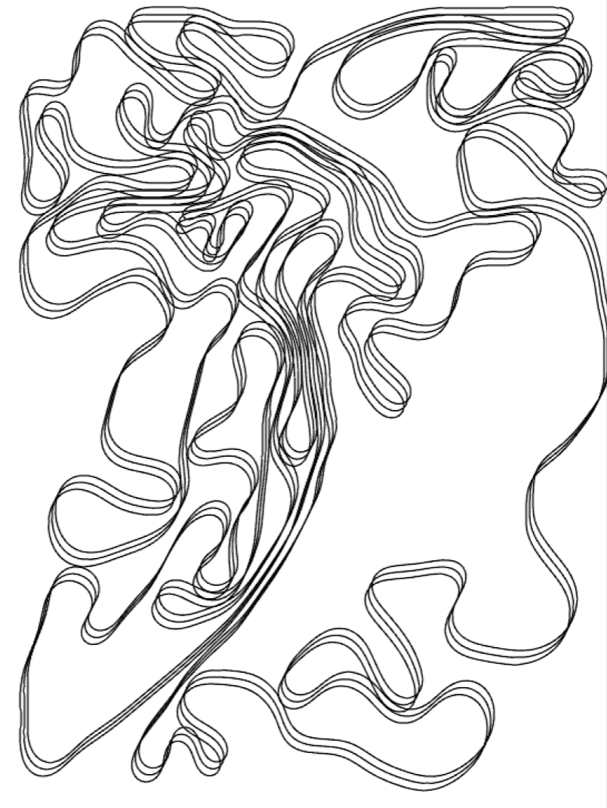
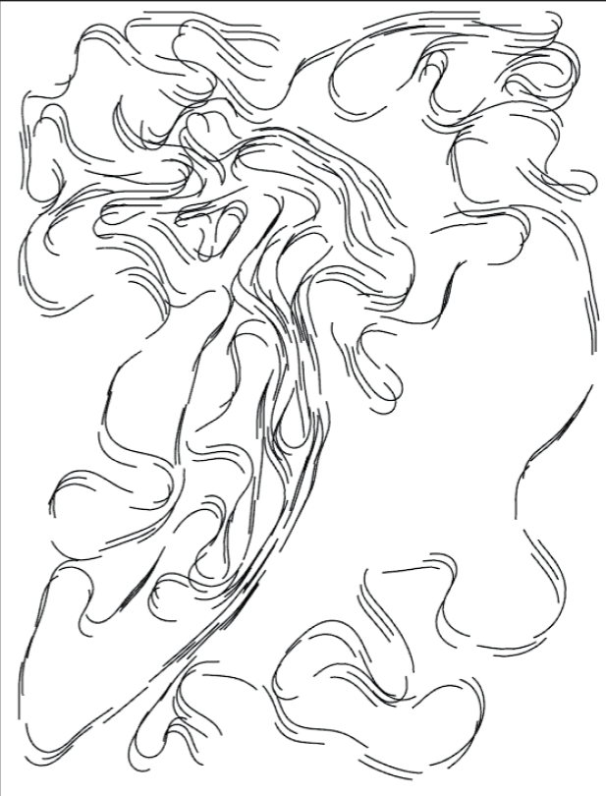
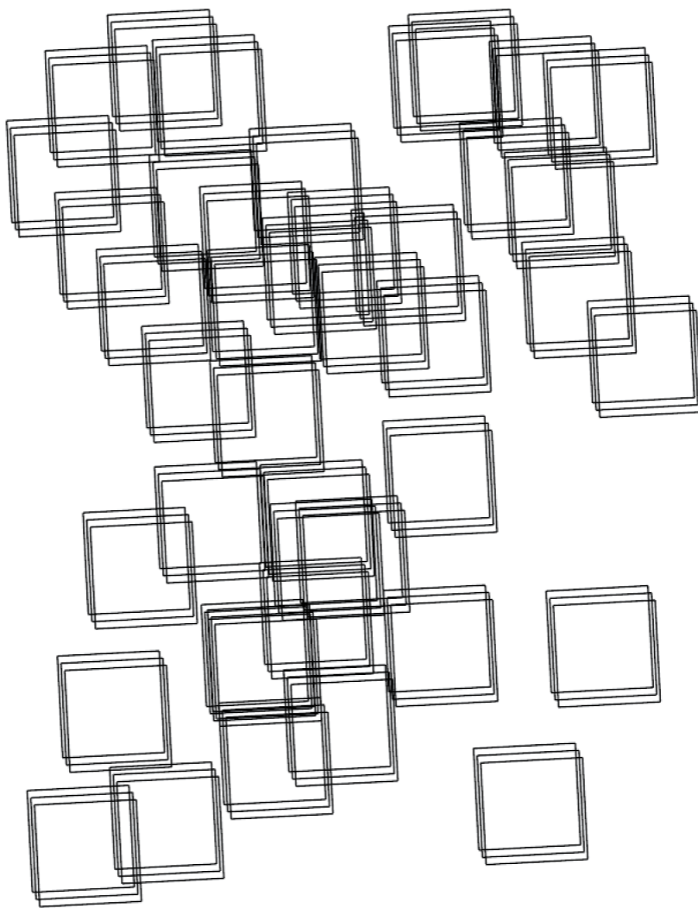
ITERATIONS Computational Exploration Here are four iterations, starting from the left with the foundational design. In the second iteration, an array was incorporated to add depth. The third iteration introduced dashed lines for added visual intrigue. The final iteration drew inspiration from Frieder Nake, a pioneer of computer art.
Notes:
Dive in the process – showcase how you work and how you came up with everything

Slide 14
PROCESS Computational Exploration In the digital era a new interaction between various fields of design and life sciences, Neurosciences and Biology. This provides a large field of various topics, within which I am working on a highly interesting phenomenon. Remarkable as fascinating, is the way in which various organisms grow.
Notes:
Dive in the process – showcase how you work and how you came up with everything

Slide 15
VISION Computational Exploration In the digital era a new interaction between various fields of design and life sciences, Neurosciences and Biology. This provides a large field of various topics, within which I am working on a highly interesting phenomenon. Remarkable as fascinating, is the way in which various organisms grow.
Notes:
Dive in the process – showcase how you work and how you came up with everything

Slide 16
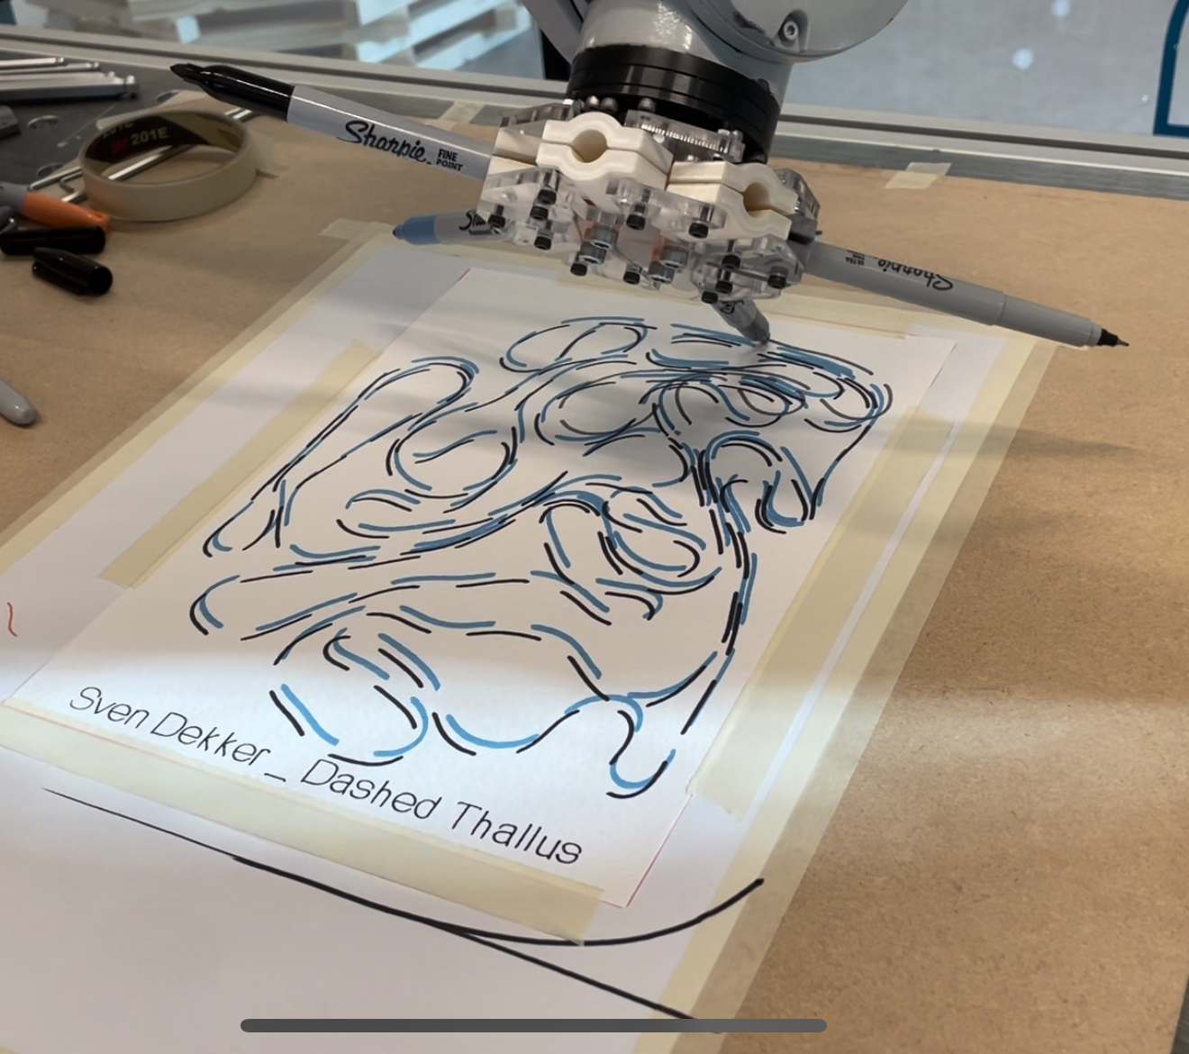
REFLECTION Achievement It's an immensely gratifying moment when the end result surpasses your initial expectations. The script used to create the drawings proved to be highly reliable and automated. Given more time, I would have relished the opportunity to begin with a fresh design and create additional drawings.
Notes:
Dive in the process – showcase how you work and how you came up with everything

Slide 17
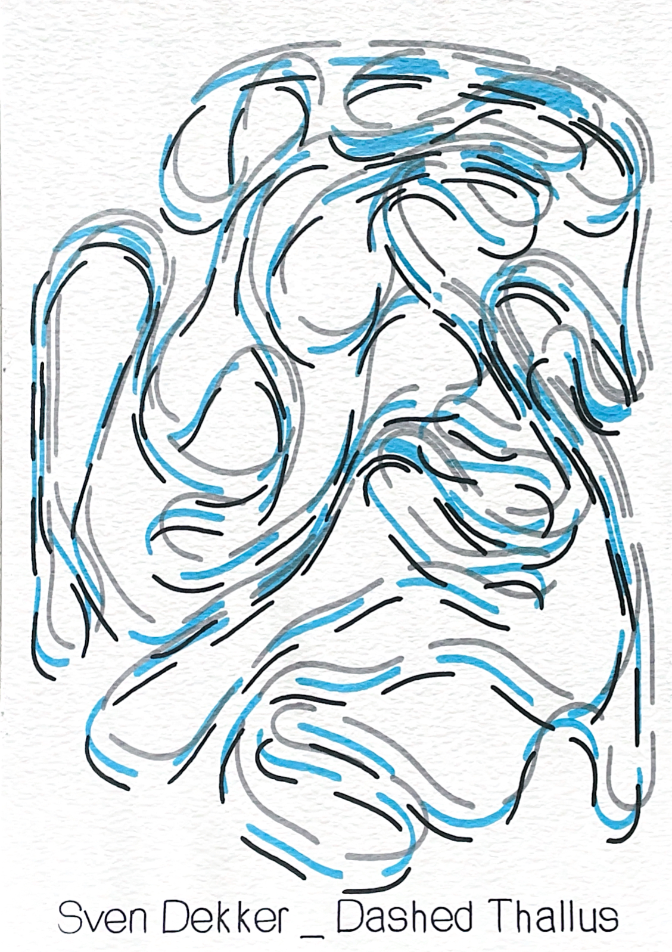
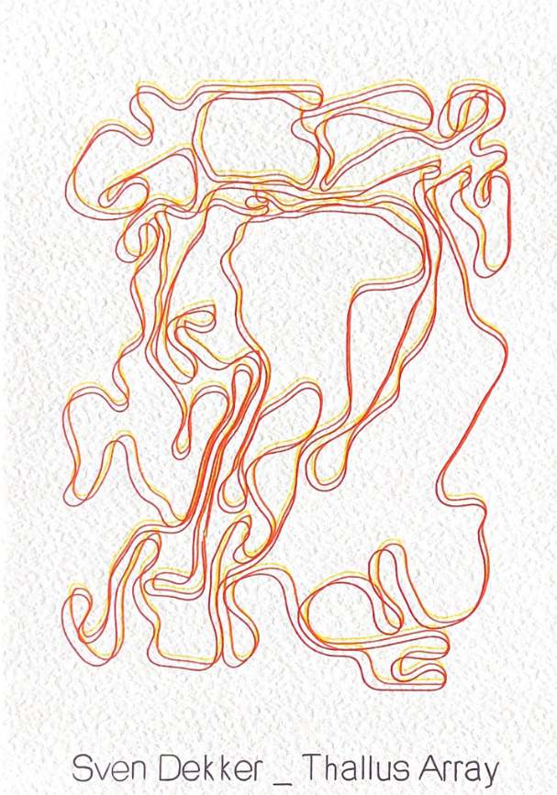

Slide 18
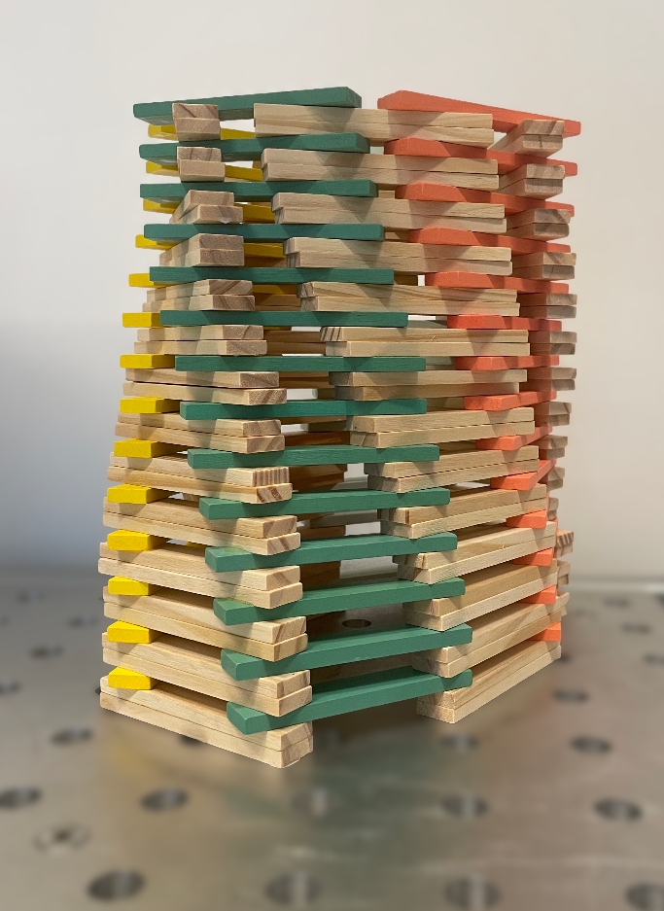
PROJECT Kapla Tower The objective of this exercise was to construct the tallest tower while also setting up a robotic system equipped with a Kapla feeder and a glue station. This task required meticulous planning and execution, as it involved not only the physical construction of the tower but also the integration of automated processes for feeding Kapla blocks and applying glue.
Notes:
Teaser
Quick description of your project in 500 – 1000 Signs
Teaser Image that shows enough of the project to make the viewer want to see more, but doesn’t show everything

Slide 19
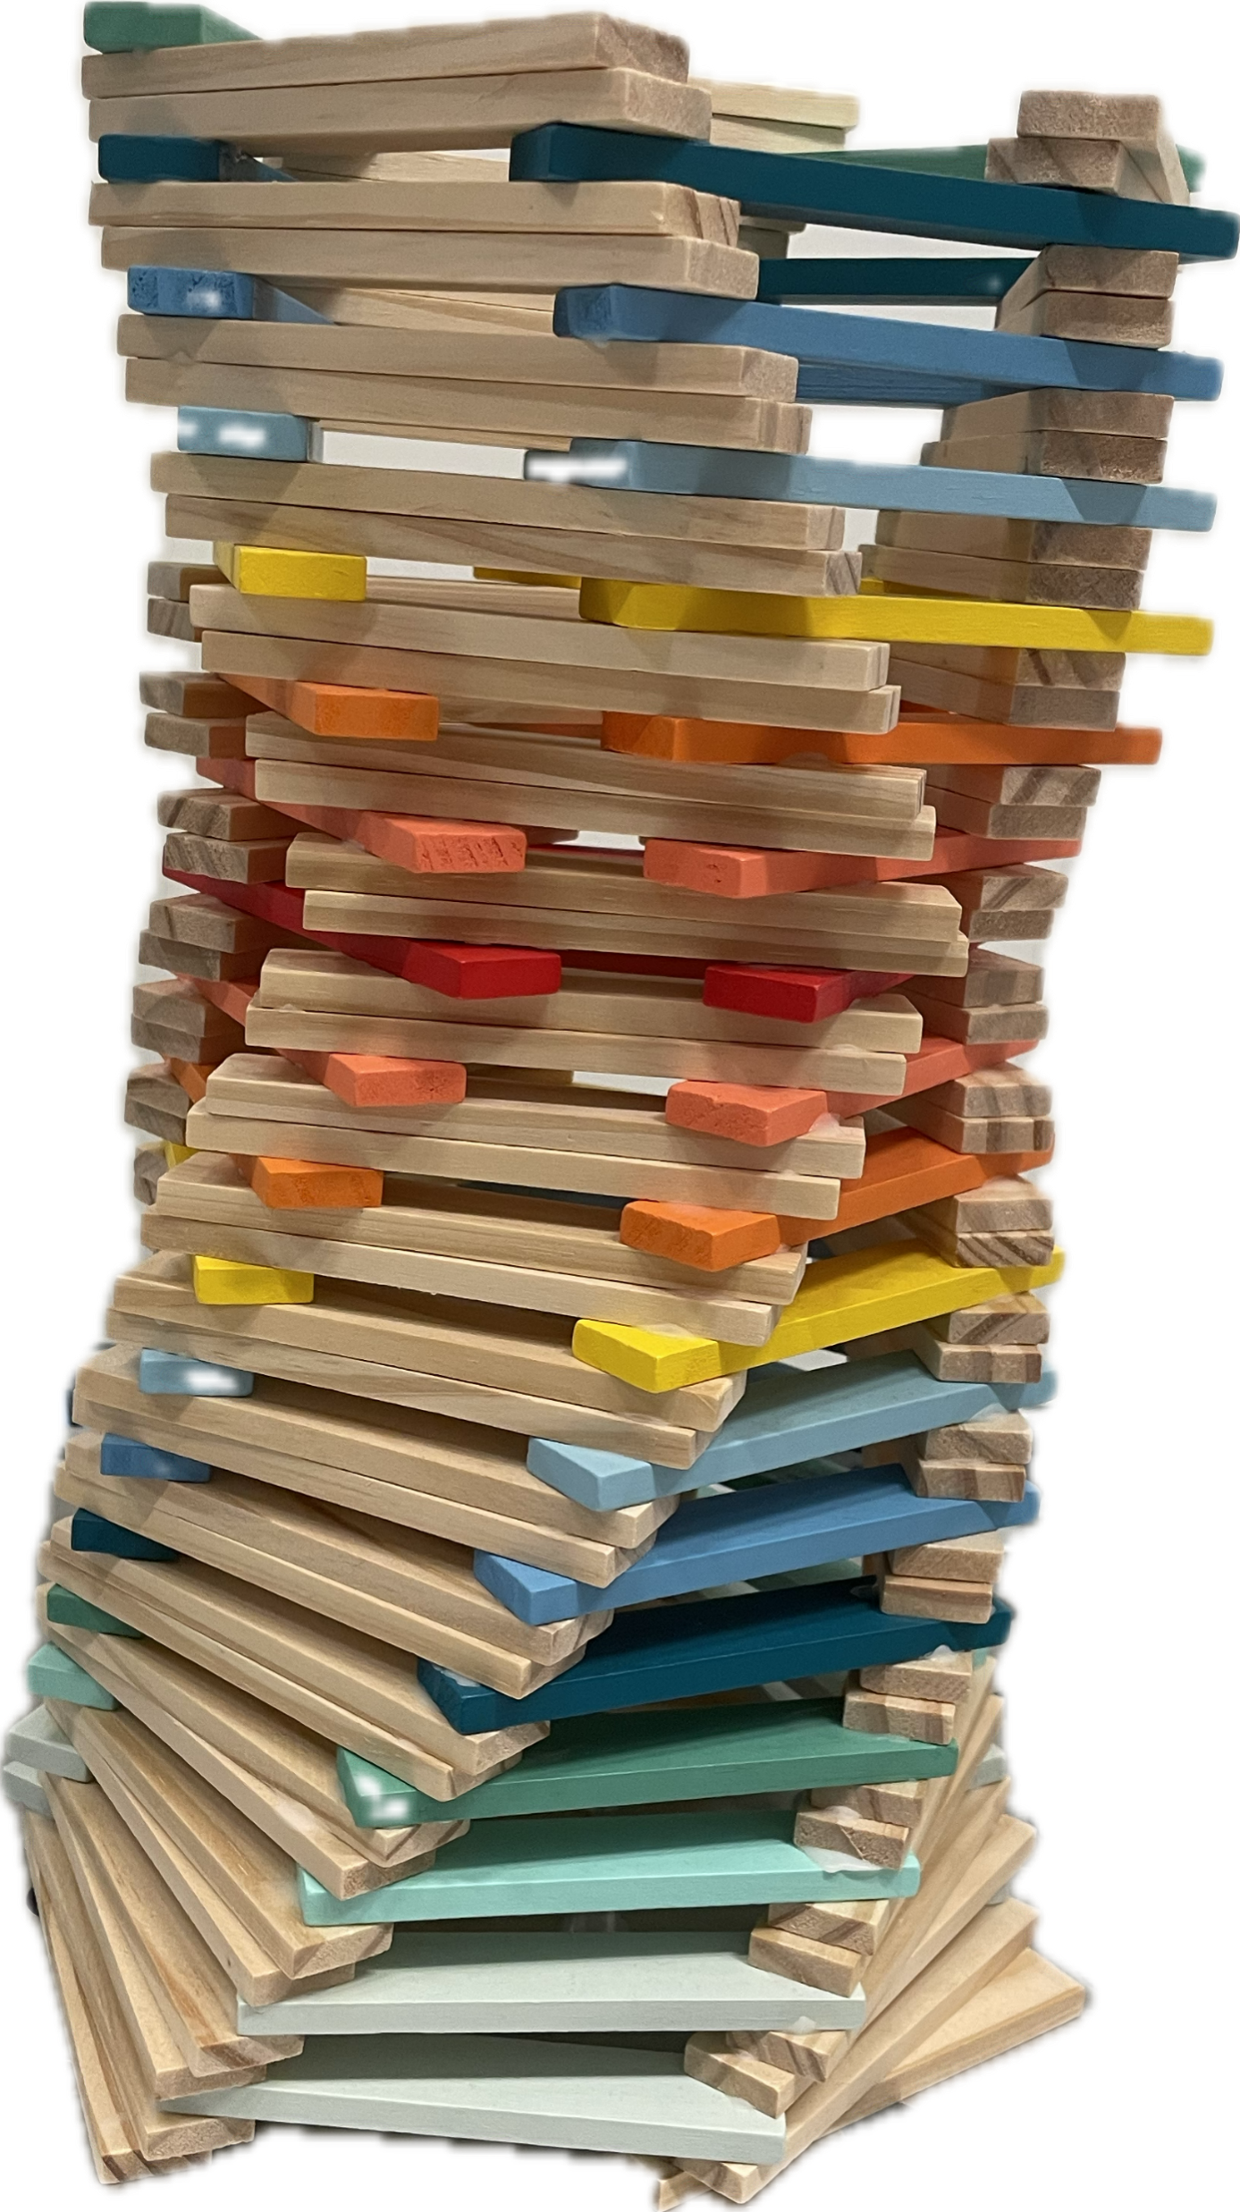
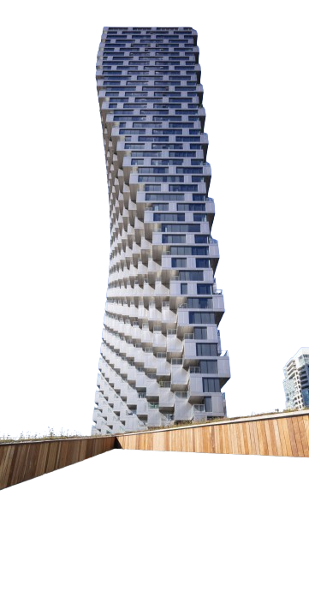
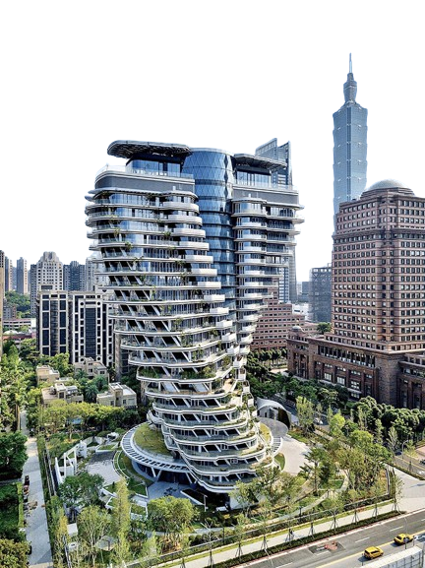
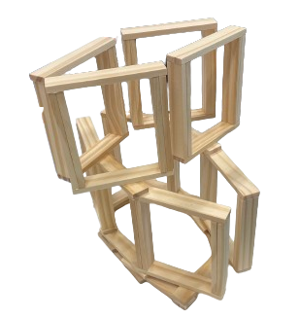
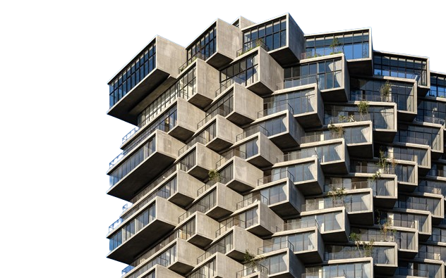
RESEARCH Inspirational Architecture The idea for the tower initially stemmed from observing various architectural buildings. A tower showcased in the RobotLAB also caught my attention, providing insights into unique construction methods. Lastly, the notion of freehand building sparked my interest, encouraging me to explore different design possibilities.
c
c
c
c
c
c
Notes:
Dive in the process – showcase how you work and how you came up with everything

Slide 20
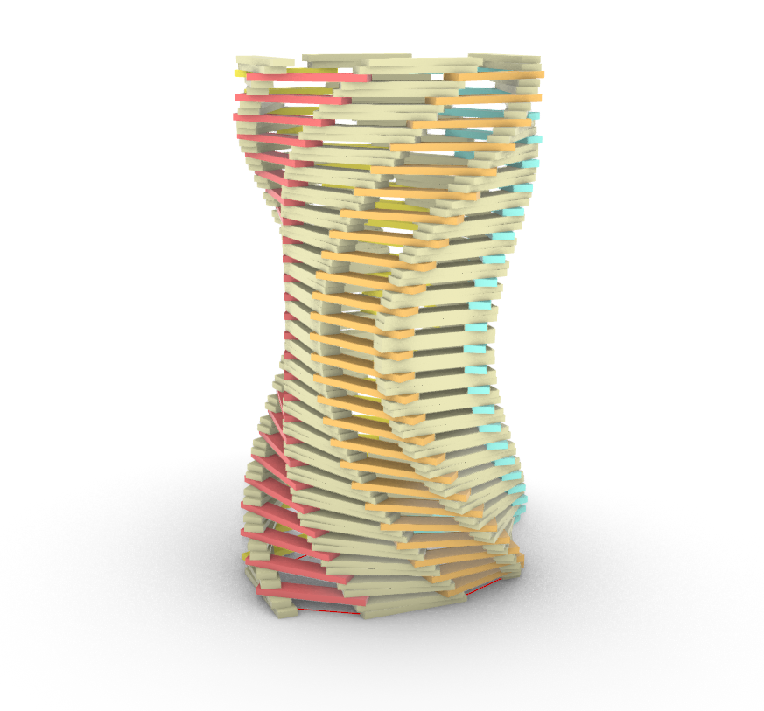
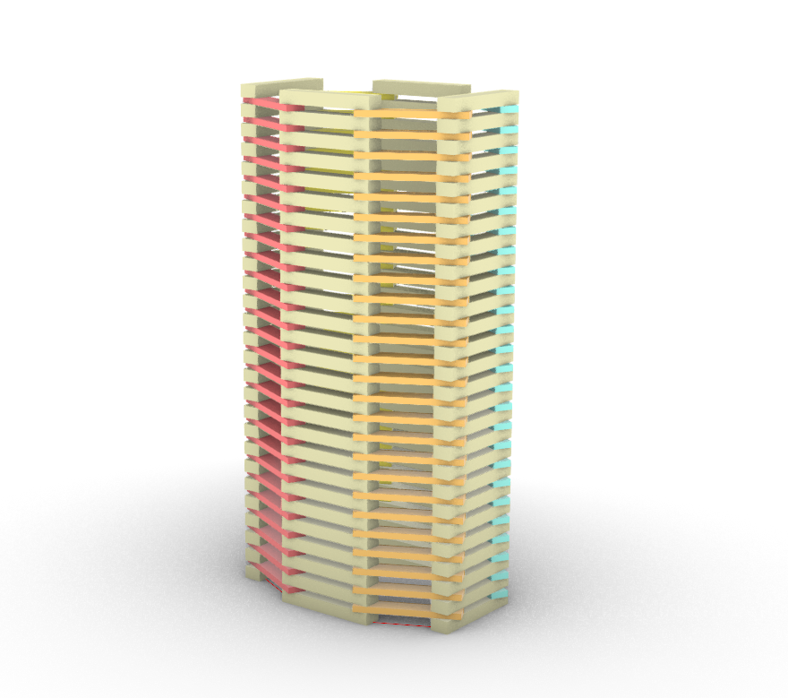
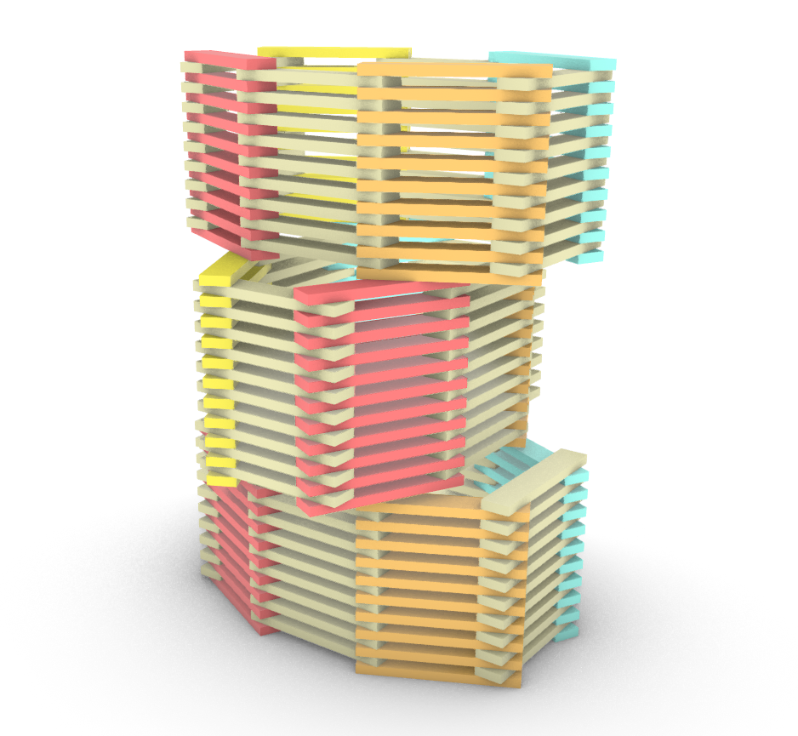
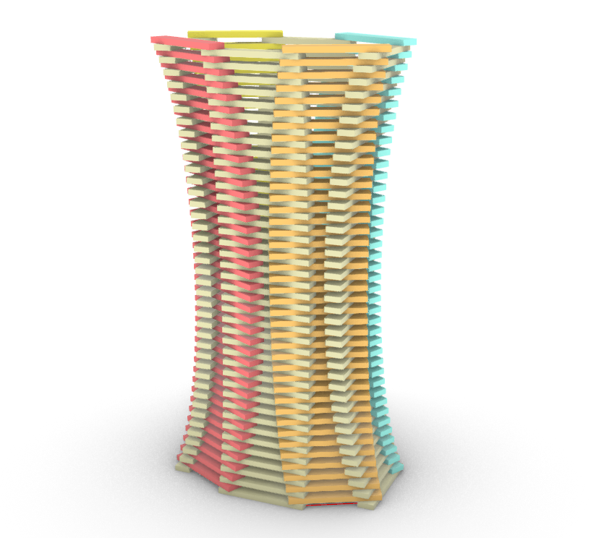
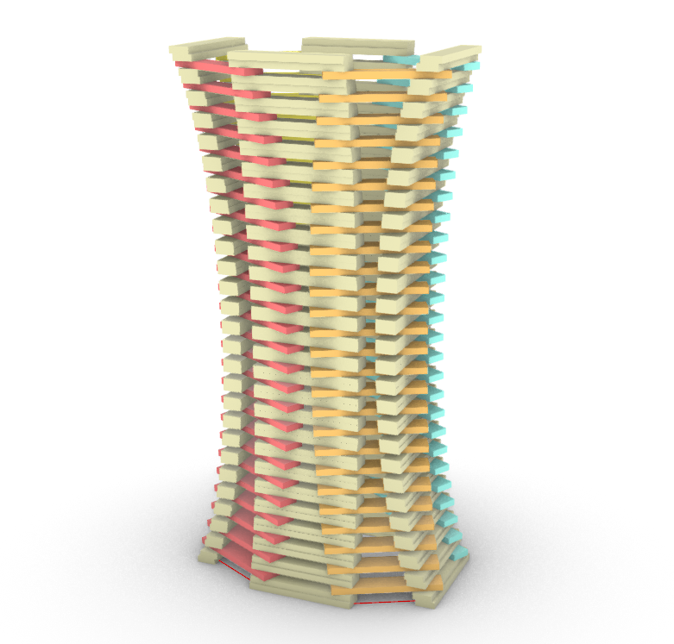
ITERATIONS Computational Exploration The tower's base takes inspiration from the freehand- built structure, forming an octagon as its foundation. In the next iteration, efforts were made to integrate bridging and overhangs, yet it lacked visual appeal. Subsequently, scaling, rotation, and the duplication of natural blocks were introduced to enrich the design, especially considering the scarcity of coloured blocks. The final iteration, portrayed on the right, embodies the culmination of these refinements.
Notes:
Dive in the process – showcase how you work and how you came up with everything

Slide 21
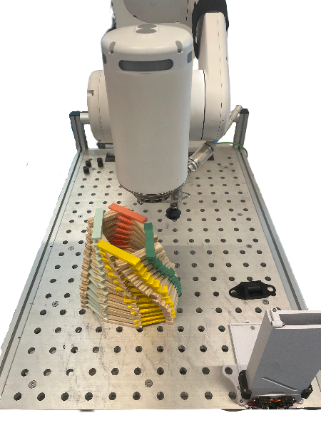
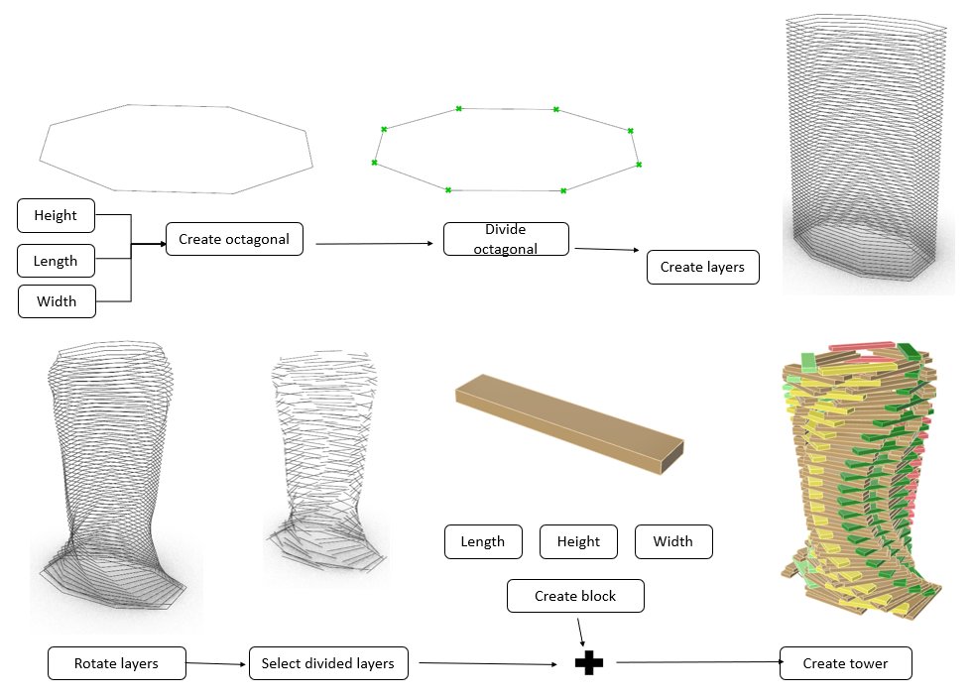
PROCESS
c
Notes:
Dive in the process – showcase how you work and how you came up with everything

Slide 22
VISION Vision Progress The initial vision aimed to construct a tower incorporating overhangs and vertically stacked blocks. However, upon experimentation, it became evident that this approach was overly ambitious given the time constraints. Consequently, the vision was scaled back, drawing inspiration from the tower already present in the room. Additionally, the constraints posed by the cobots limited the creative freedom, presenting challenges in crafting something truly unique.
Notes:
Dive in the process – showcase how you work and how you came up with everything

Slide 23
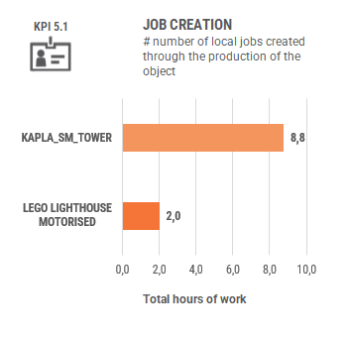
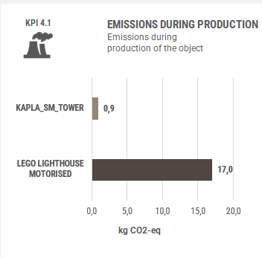
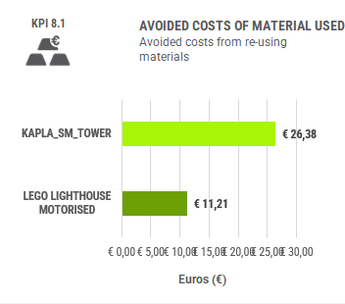
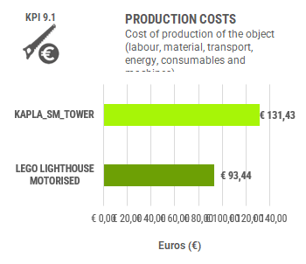
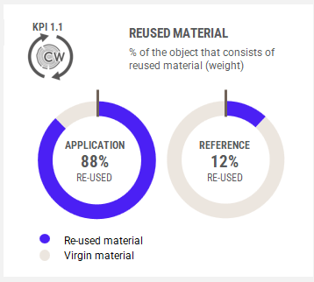
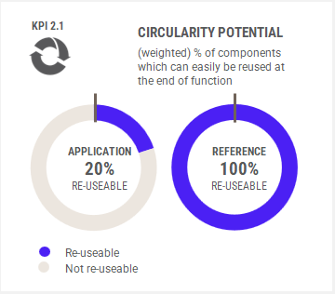
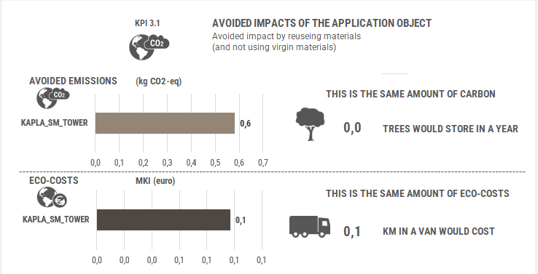
KPI Circularity After completing the kapla tower challenge, we meticulously gathered data on the build process to conduct an impact evaluation. Our aim is to gain deeper insights into circularity, ensuring that we maximize efficiency and sustainability in our endeavours.
Notes:
Dive in the process – showcase how you work and how you came up with everything

Slide 24

REFLECTION Annoyance A significant amount of time was devoted to developing a functional script for the cobots, which proved to be quite frustrating, especially as we observed towers being constructed around the room. This experience felt like time wasted, but we recognized that problem- solving is an integral aspect of the learning process. As we finally began construction, we found ourselves under a time constraint, exacerbated by the RobotLAB running out of usable Kapla blocks.
Notes:
Dive in the process – showcase how you work and how you came up with everything

Slide 25


GLUE STATION
Notes:
Dive in the process – showcase how you work and how you came up with everything

Slide 26


Slide 27

PROJECT One Plank Challenge The goal of this makethon was to create an item for the Stayokay hotel using only a single plank of birch plywood sourced from the hotel's own recycled materials. This required a thorough grasp of Grasshopper scripting. Additionally, we had to consider key performance indicators (KPIs) and make choices that would facilitate future circularity, ensuring sustainability and ease of reusability down the line.
Notes:
Teaser
Quick description of your project in 500 – 1000 Signs
Teaser Image that shows enough of the project to make the viewer want to see more, but doesn’t show everything

Slide 28




RESEARCH Inspirational Mood board The concept for the chair originated from our observations of the Stayokay hotel. Recognizing that the target audience often consists of budget-conscious travellers, resulting in smaller rooms, we sought to optimize the space by focusing on innovative solutions. Given the hotel has communal areas, we aimed to enhance the room’s simplicity and visual appeal. Thus, we envisioned a chair that could be easily hung on the wall, creating a sense of spaciousness and flexibility within the room layout.
c
c
c
c
c
Notes:
Dive in the process – showcase how you work and how you came up with everything

Slide 29





ITERATIONS Improving Design Our journey began with research, where we initially adopted an open-source design with established dimensions. To refine the concept, we employed a laser cutter to produce life-sized models, enabling us to identify areas for enhancement. This iterative process led us to iteration 3, which we crafted early on during the makethon. Building upon feedback from the initial prototype, we iterated further to create iteration 4, resulting in a significantly enhanced version.
Iteration 4
Iteration 1
Iteration 2
Iteration 3
Notes:
Dive in the process – showcase how you work and how you came up with everything

Slide 30


VISION Vision Progress The initial vision was to create a folding chair that surpassed its inspirations in every aspect. Leveraging robotic milling production enabled us to achieve unprecedented precision in angles, vastly enhancing both comfort and structural integrity. Significant focus was also dedicated to optimizing the chair's height and overall seating experience within the constraints of the One Plank Challenge parameters.
Notes:
Dive in the process – showcase how you work and how you came up with everything

Slide 31

KPI Circularity Following the One Plank Challenge, we diligently compiled data on the construction process to facilitate an impact assessment. Our objective is to delve deeper into the concept of circularity, striving to optimize efficiency and sustainability in our initiatives.
Notes:
Dive in the process – showcase how you work and how you came up with everything

Slide 32
REFLECTION Manufacturing Constraint I'm thrilled to introduce a functional folding chair that’s ready for use in hotels. While we weren't able to finalize the v2 design due to manufacturing constraints. We developed a computational workflow using Rhino and Grasshopper to mill with angels and conducted essential tests. One of the most exciting aspects is leveraging the capabilities of the robot multiple axes, which surpass those of a conventional CNC mill and adds a unique edge to our project.
Notes:
Dive in the process – showcase how you work and how you came up with everything

Slide 33



Slide 34

PROJECT Bringing The Forest Into The City The goal of this Makethon was to create an urban interface for “The Green Mile” project that combines new/circular wood, forest wood, and a joinery system. I was part of the milling script team, and I would like to go into detail about my contributions to this project.
Notes:
Teaser
Quick description of your project in 500 – 1000 Signs
Teaser Image that shows enough of the project to make the viewer want to see more, but doesn’t show everything

Slide 35



RESEARCH Computational Design The computational design team discovered the Cockroach plugin for Grasshopper, which facilitates fast and easy geometric manipulation, characterization, and decomposition of point clouds. This is particularly beneficial because the 3D scanning app used provided highly detailed point clouds. As a result, it became possible to computationally create milling toolpaths based on the branch's geometry.
3D Point Cloud
Generate Joints
Notes:
Dive in the process – showcase how you work and how you came up with everything

Slide 36




ITERATIONS Prototype Milling Scripts Before the team finalized the design, the computational design team created some milling scripts to challenge ourselves and show the design team some examples of what would be possible. One great example of a computational design uses the intersection of the plank and the branch to create a milling toolpath. This toolpath is based on the rotation, angle, and depth of the intersection. By moving the plank to the desired location, the milling script is automatically generated.
Notes:
Dive in the process – showcase how you work and how you came up with everything

Slide 37














CONTRIBUTION Joint Transition The process for the final joint transition is as follows: 1. Import the point cloud. 2. Divide the branch into parts. 3. Grab the plane from the base of the branch. 4. Get the widest diameter of the branch. 5. Create the shape we want to mill into the wood. 6. Create milling paths to achieve the desired shape. 7. Result
1.
2.
3.
4.
5.
6.
7.
Notes:
Dive in the process – showcase how you work and how you came up with everything

Slide 38

Result Urban Interface This amazing urban interface structure is our minor contribution to “The Green Mile.” Collaboration and great teamwork were required from the design team, joint team, milling team, robotic production team and KPI team to achieve this end result.
Notes:
Dive in the process – showcase how you work and how you came up with everything

Slide 39





KPI Circularity Following the “The Green Mile” project, we diligently compiled data on the construction process to facilitate an impact assessment. Our objective is to delve deeper into the concept of circularity, striving to optimize efficiency and sustainability in our initiatives.
Reused Material
Circularity Potential
Emissions // Production
Avoided Impact
Avoided Costs
Maintenance Cost
Production Cost
Job Creation
Notes:
Dive in the process – showcase how you work and how you came up with everything

Slide 40

REFLECTION Potential I am proud of the things we have achieved as a team and proud of all the things I have learned in this project and minor. This project has only intrigued me more about the possibilities of parametric and computational design. I have already applied my newly learned skills in Rhino and Grasshopper to a personal project. I am excited to take two more subjects next school year!
Notes:
Dive in the process – showcase how you work and how you came up with everything

Slide 41



Slide 42



